Slide 1

Emerging technology meetups
Series #1
BIG DATA
November 16, 2018

Slide 2
Big data: outline and schedule
THEORY
PRACTICE WITH DATA BRICKS
Background/Motivations
Hello World
Graphical Analysis
Machine Learning
30 minutes
5 minutes
20 minutes
35 minutes

Slide 3






Disruption: big compute vs. big data
BIG COMPUTE
VS
BIG DATA
Analytical Approach
Model intensive
Resources?
Supercomputing
Forecasting
In Jan: we predict the flu in all 48 states by the end of March
Empirical Approach
Data intensive
Resources?
Datacenters, cheap hardware
Nowcasting
In Dec: 37.2M people googled flu symptoms in 22 states

Slide 4




Forecasting vs. nowcasting
FORECASTING
VS
NOWCASTING – WE’RE ALL SENSORS
Weather
Climatological Modeling
Cell Phone Coverage
Electro-Magnetic propagation model
Vegetation, Weather
Seasonal Flu Progress
Office visits → CDC
Epidemic propagation model
Traffic Prediction
Network analysis
Queueing theory
Monte Carlo simulation
Weather
Yellowstone migration early?
Cell Phones
Verizon connectivity log failures?
Seasonal Flu
How many people are googling flu
Traffic
Internet traffic
Sick days
Air quality Sensors

Slide 5

Example: green eggs and ham
GEAH.txt
WORD OCCURENCES?
I am Daniel
I am Sam
Sam I am
that Sam I am that Sam I am
I do not like that Sam I am
Do you like Green eggs and ham
I do not like them Sam I am
I do not like Green eggs and ham
Sam: 6
I: 10
am: 7

Slide 6

Green eggs: initial mapping
Text | Word Counts
I am Daniel I am Sam Sam I am | {I:3, am:3, Daniel:1, Sam:2}
That Sam I am that Sam I am | {that:2, Sam:2, I:2, am:2}
I do not like that Sam I am | {I:2, do:1, not:1, like:1, that: 1, Sam:1, am:1}
Do you like green eggs and ham | {Do:1, you:1, like:1, green:1, eggs:1, and:1, ham:1}
I do not like them Sam I am I do not like green eggs and ham | {I:3, do:2, not:2, like:2, them:1, Sam:1, am:1, green:1, eggs:1, and:1, ham:1}
Remove blank lines, selectively remove <cr> to get verses
4 blank lines, 9 <cr>
Count word occurrences by verse
Map them into a hash table
Reduce to minimum key-value pairs
Summarized values – I:10, am:7, Sam: 6, etc.

Slide 7

Green eggs: progressive aggregation
Text | Word Counts
I am Daniel I am Sam Sam I am | {I:3, am:3, Daniel:1, Sam:2}
That Sam I am that Sam I am | {that:2, Sam:2, I:2, am:2}
I do not like that Sam I am | {I:2, do:1, not:1, like:1, that: 1, Sam:1, am:1}
Do you like green eggs and ham | {Do:1, you:1, like:1, green:1, eggs:1, and:1, ham:1}
I do not like them Sam I am I do not like green eggs and ham | {I:3, do:2, not:2, like:2, them:1, Sam:1, am:1, green:1, eggs:1, and:1, ham:1}
Word Counts
{I:5, am:5, Daniel:1, Sam:4}
{that:2}
Word Counts
{I:10, am:7, Daniel:1, Sam:6, that:3, do:3, not:3, like:3, you:1, green:2, eggs:2, and:2, ham:2, them:1}
Word Counts
{I:5, do:3, not:3, like:3, that:1, Sam:2, am:2}
{you:1, green:2, eggs:2, and:2, ham:2}
{them:1}

Slide 8
Big problem: very large files
PROGRESSIVE AGGREGATION
GOOGLE SOLVED
Very large files lead to very large result sets
Each aggregation step requires significant resources to accomplish
No leverage of parallel/distributed computing
2004
Map-Reduce
Reduction is still a distributed solution
Doesn’t concentrate output
Utilizes differences between mappers and reducers

Slide 9
Big IDEA: MAP REDUCE
Hadoop – first Map-Reduce Engine for scale
Distributed file system
Cluster Management
Map-Reduce Engine
Spark – first performance-focused enhancement
Leverage HW improvements
In memory computing
Simplify programming experience
Many useful abstractions
Avoid ‘throwaway’ analysis
Spark Packages
Spark SQL
Streaming
MLLib (Machine Learning Repository)
GraphX
Map
Clean
Transform
Structure
Reduce
Sort
Summarize
Data Store
Iterate

Slide 10
Green eggs: INITIAL MAP REDUCE
Text
I am Daniel I am Sam Sam I am
That Sam I am that Sam I am
I do not like that Sam I am
Do you like green eggs and ham
I do not like them Sam I am I do not like green eggs and ham
Mapped Word Counts
{I:3, am:3, Daniel:1, Sam:2}
{that:2, Sam:2, I:2, am:2}
{I:2, do:1, not:1, like:1, that: 1, Sam:1, am:1}
{Do:1, you:1, like:1, green:1, eggs:1, and:1, ham:1}
{I:3, do:2, not:2, like:2, them:1, Sam:1, am:1, green:1, eggs:1, and:1, ham:1}
Reduced Word Counts
{I:10, am:7, Daniel:1, Sam:6}
{that:3}
{do:3, not:3, like:3}
{you:1, green:2, eggs:2, and:2, ham:2}
{them:1}

Slide 11
Green eggs: reduce step, size allocation
Text
I am Daniel I am Sam Sam I am
That Sam I am that Sam I am
I do not like that Sam I am
Do you like green eggs and ham
I do not like them Sam I am I do not like green eggs and ham
Mapped Word Counts
{I:3, am:3, Daniel:1, Sam:2}
{that:2, Sam:2, I:2, am:2}
{I:2, do:1, not:1, like:1, that: 1, Sam:1, am:1}
{Do:1, you:1, like:1, green:1, eggs:1, and:1, ham:1}
{I:3, do:2, not:2, like:2, them:1, Sam:1, am:1, green:1, eggs:1, and:1, ham:1}
Reduced Word Counts
{I:10, am:7, Daniel:1}
{Sam:6, that:3, do:3}
{not:3, like:3, you:1}
{green:2, eggs:2, and:2}
{ham:2, them:1}

Slide 12
Green eggs: reduce step, sorting by value
Text
I am Daniel I am Sam Sam I am
That Sam I am that Sam I am
I do not like that Sam I am
Do you like green eggs and ham
I do not like them Sam I am I do not like green eggs and ham
Mapped Word Counts
{I:3, am:3, Daniel:1, Sam:2}
{that:2, Sam:2, I:2, am:2}
{I:2, do:1, not:1, like:1, that: 1, Sam:1, am:1}
{Do:1, you:1, like:1, green:1, eggs:1, and:1, ham:1}
{I:3, do:2, not:2, like:2, them:1, Sam:1, am:1, green:1, eggs:1, and:1, ham:1}
Reduced Word Counts
{I:10, am:7, Sam:6}
{that:3, do:3, not:3}
{like:3, green:2, eggs:2}
{and:2, ham:2, Daniel:1}
{them:1, you:1}

Slide 13
architectures: i/o and iteration
Text
I am Daniel I am Sam Sam I am
That Sam I am that Sam I am
I do not like that Sam I am
Do you like green eggs and ham
I do not like them Sam I am I do not like green eggs and ham
Mapped Word Counts
{I:3, am:3, Daniel:1, Sam:2}
{that:2, Sam:2, I:2, am:2}
{I:2, do:1, not:1, like:1, that: 1, Sam:1, am:1}
{Do:1, you:1, like:1, green:1, eggs:1, and:1, ham:1}
{I:3, do:2, not:2, like:2, them:1, Sam:1, am:1, green:1, eggs:1, and:1, ham:1}
Reduced Word Counts
{I:10, am:7, Sam:6}
{that:3, do:3, not:3}
{like:3, green:2, eggs:2}
{and:2, ham:2, Daniel:1}
{them:1, you:1}
Source Input
Iteration

Slide 14

architectures: in memory
Text
I am Daniel I am Sam Sam I am
That Sam I am that Sam I am
I do not like that Sam I am
Do you like green eggs and ham
I do not like them Sam I am I do not like green eggs and ham
Mapped Word Counts
{I:3, am:3, Daniel:1, Sam:2}
{that:2, Sam:2, I:2, am:2}
{I:2, do:1, not:1, like:1, that: 1, Sam:1, am:1}
{Do:1, you:1, like:1, green:1, eggs:1, and:1, ham:1}
{I:3, do:2, not:2, like:2, them:1, Sam:1, am:1, green:1, eggs:1, and:1, ham:1}
Reduced Word Counts
{I:10, am:7, Sam:6}
{that:3, do:3, not:3}
{like:3, green:2, eggs:2}
{and:2, ham:2, Daniel:1}
{them:1, you:1}
Source Input
Iteration

Slide 15



Big data: scalable architecture
COLLECT, STORE, ANALYZE
INNOVATION
Collection requires gathering streams of data
connectivity (network)
storage (cloud)
Storage requires very large (Pb) cloud resources
Google Web Index > 10 Pb
MS Moving > 4 Pb daily
Analysis requires transform/sort/aggregate
I/O bound
Machines Fail
High CPU/Disk hard/soft failures
Clustering (10K – 1M servers)
Distributed/Parallel computing
Task decomposition
Fault tolerant (repatriation)
Original approach: DB -> CPU
Iterative/layered
I/O intensive
Ex: Hadoop DFS Map-Reduce
New approach: DB -> Mem -> CPU
Iterative/Layered Memory
10-100x speed improvement
Ex: Spark RDD’s

Slide 16


USING SPARK & DATABRICKS
SQL, Streaming, ML, Graphs
Useful Abstractions
Resilient Distributed Datasets
Data Frames
Accumulators
Process Improvements
Caching
Lazy evaluation of expressions
Only when forced to produce value
Analysis as Code
Schema/Schema Later/No Schema
Schema inference
Jupyter Notebook
Spark SQL, Pyspark, Scala, etc.
Read, Eval, Print, Loop (REPL)
Lisp: (loop (print (eval (read))))
Data importing
Library importing
Provisioning Interface
Cluster definition
Execution
Job monitoring and analysis
Analysis as code
Storage
Versioning

Slide 17
Spark Dataframes - Distributed
From Mleap’s Documentation on data frames –
Spark's data frames are optimized for distributed computation, making them excellent for processing large datasets. They are very heavy-weight, as they need to handle network failure scenarios, compilation of execution plans, redundancy, and many other requirements in a distributed context. Spark data frames offer a lot of functionality outside of ML pipelines, such as joining large datasets, mapping, reducing, SQL queries, etc.
Scikit-learn data frames are provided by Pandas and NumPy. These are lightweight data structures, and offer quite a bit of the same functionality as Spark data frames, minus the distributed nature of Spark's data frames.
Tensorflow does not have data frames like Spark, Scikit-learn and MLeap. Instead, Tensorflow relies on input nodes and output nodes, connected by a graph of transfomation operations. This paradigm is actually neatly compatible with data frames, as certain columns can be used to provide data for the input nodes, while output nodes can be placed in new columns of a data frame. Leap frames are specifically designed to be compatible with Tensorflow graphs, Spark data frames, and to a certain extent, Scikit-learn data frames.

Slide 18
Operations on RDD’s
Driver Nodes
Worker Nodes
Computed Closure of Operation for Workers
Aka ‘executors’
Only modify variables in their closure
Accumulators used to return individual results
Closure
Tasks
Accumulators
Driver
Workers

Slide 19

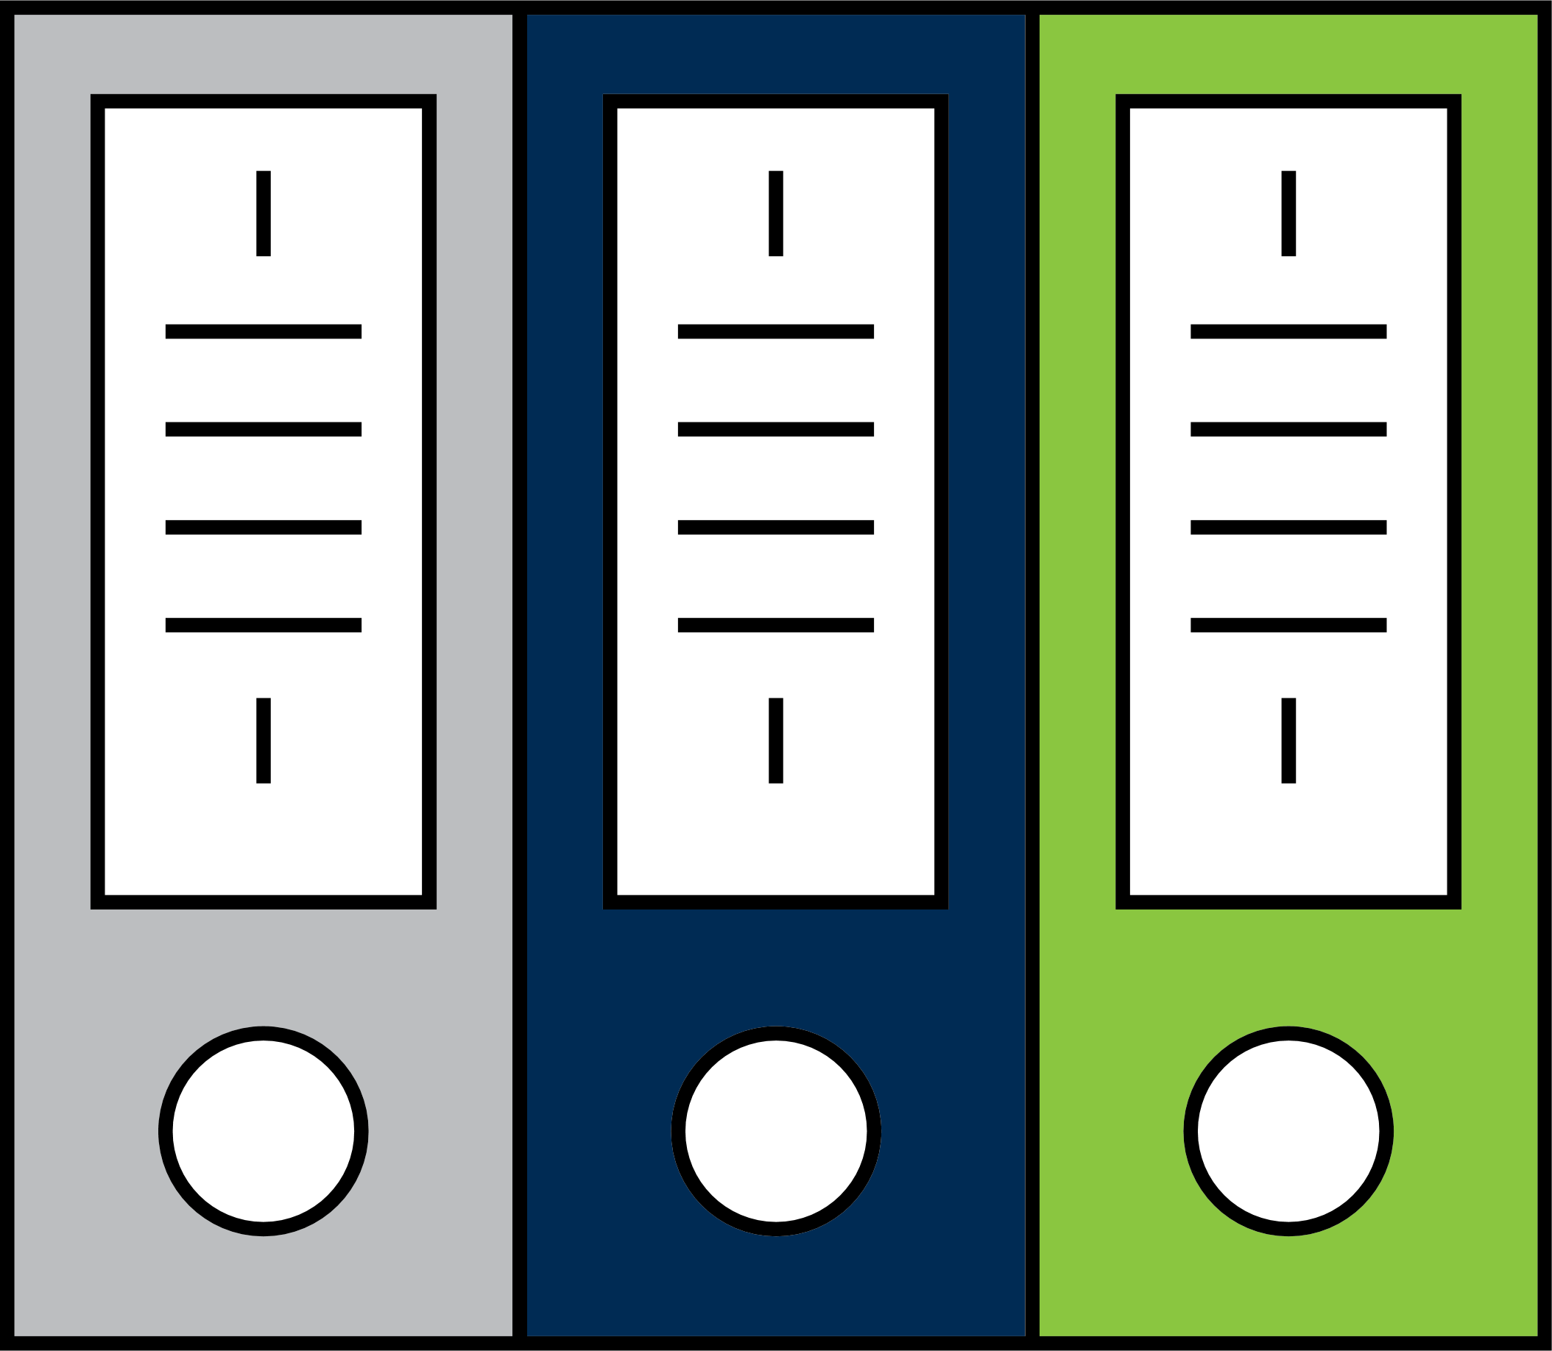
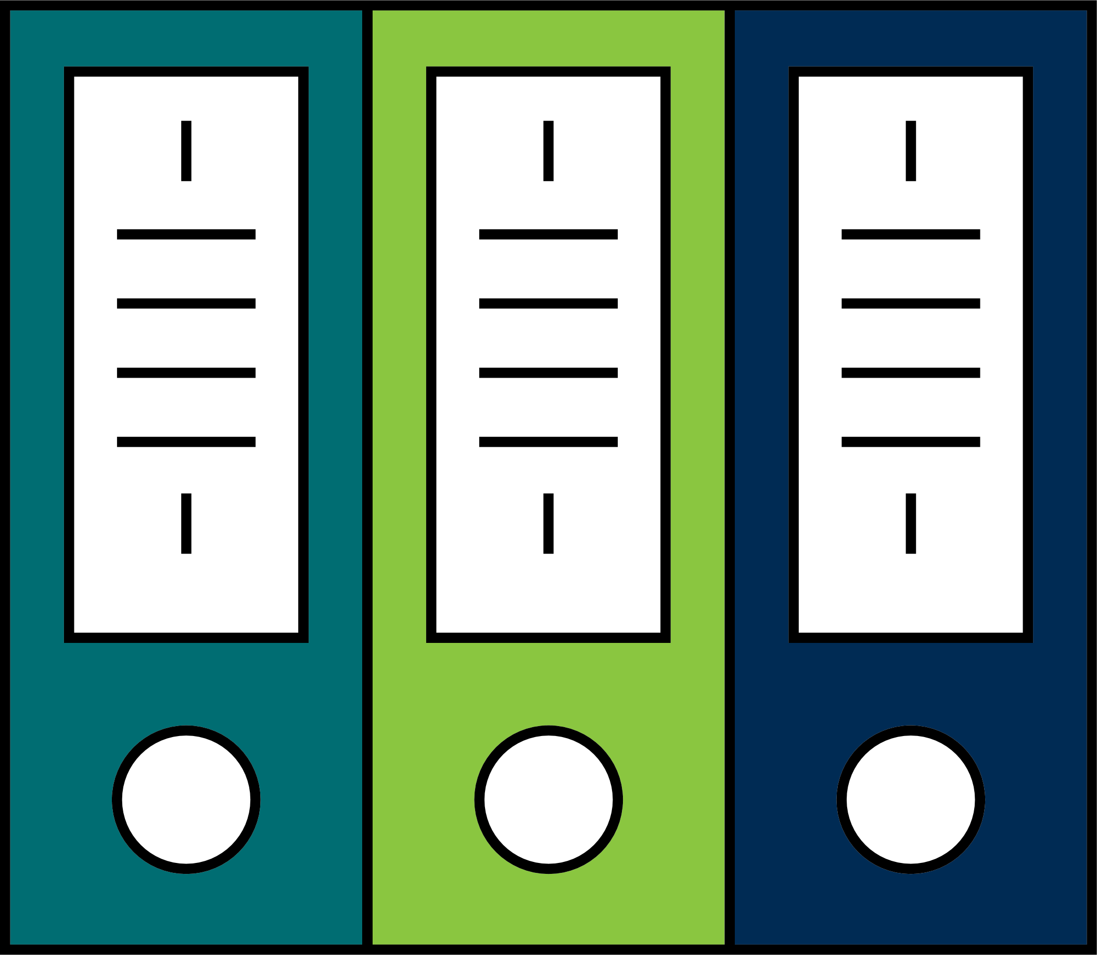
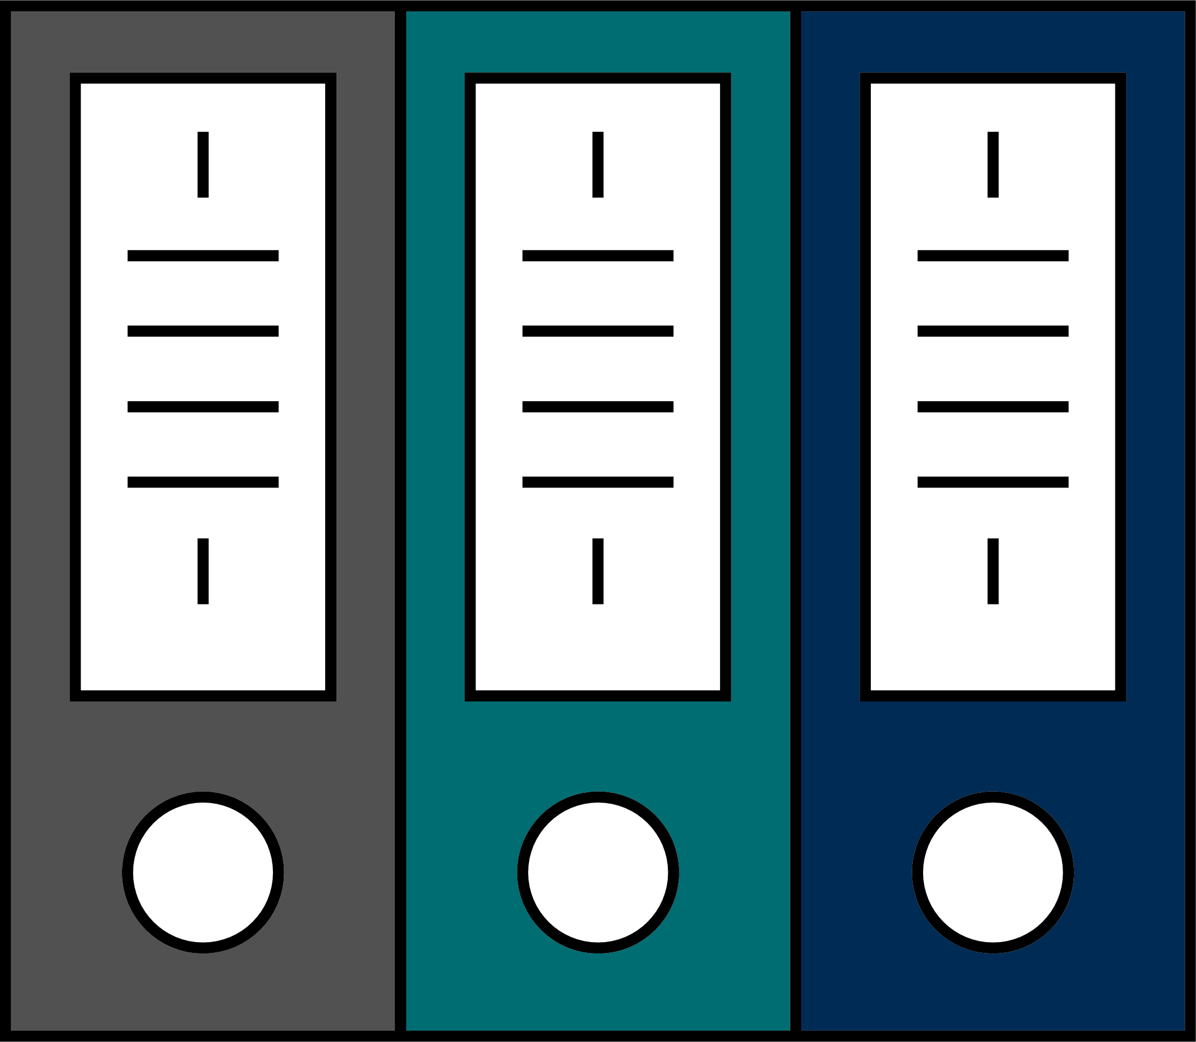
DATABRICKS EXAMPLES:
Hello World of Databricks
Files in the wild
Databricks File System (DBFS)
Resilient Distributed Datasets (RDD’s)
Dataframes (DF), Datasets
Tables
Import
Define
Files in Wild
DBFS (distributed)
RDD’s Partitioned
DF/DS as Tables

Slide 20
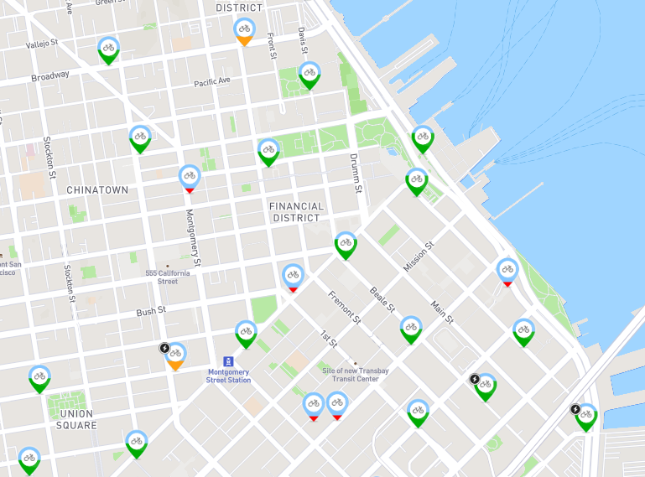

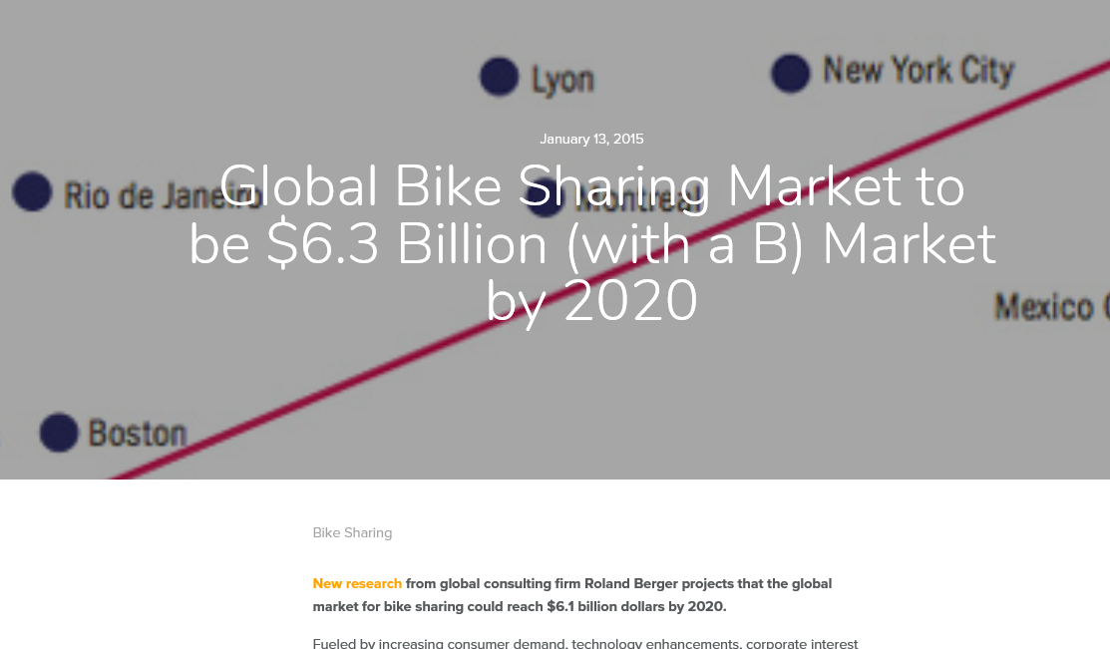
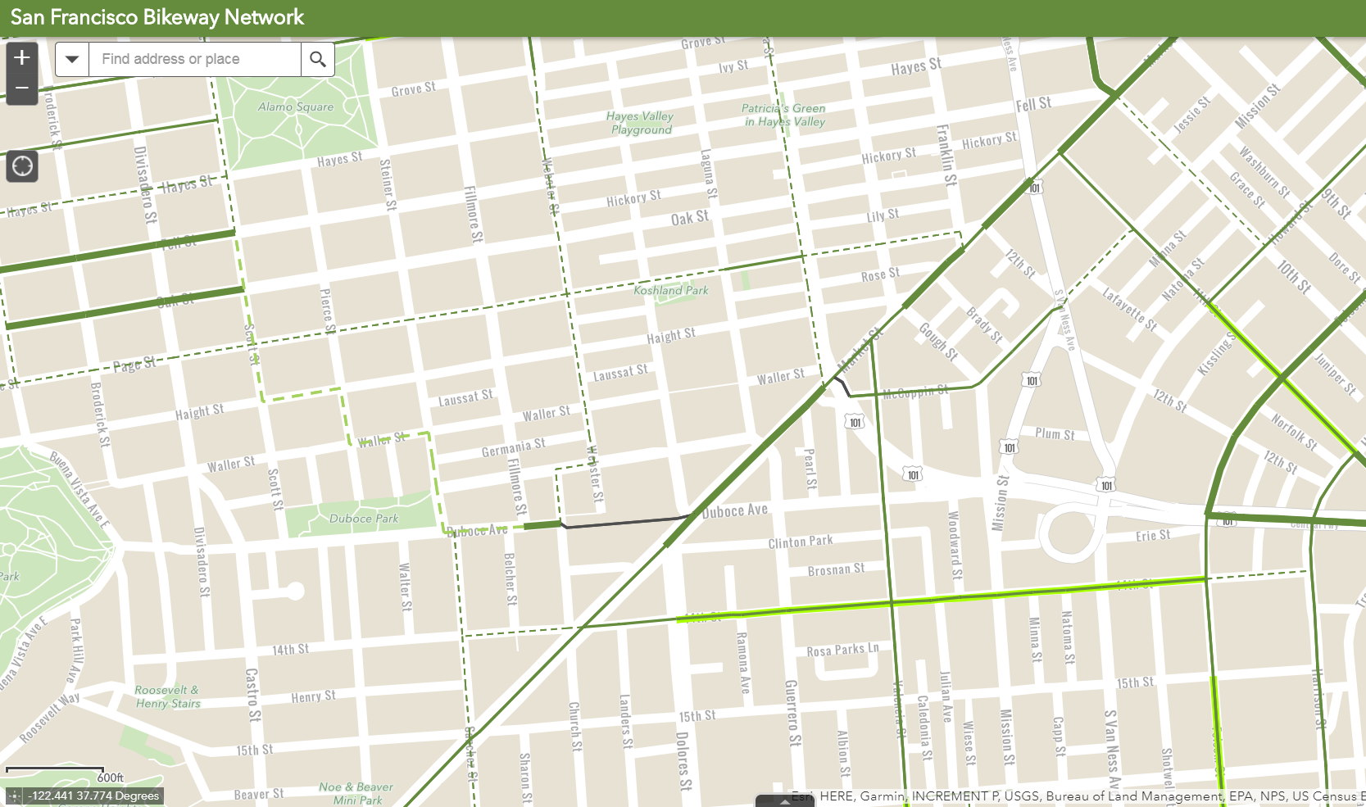
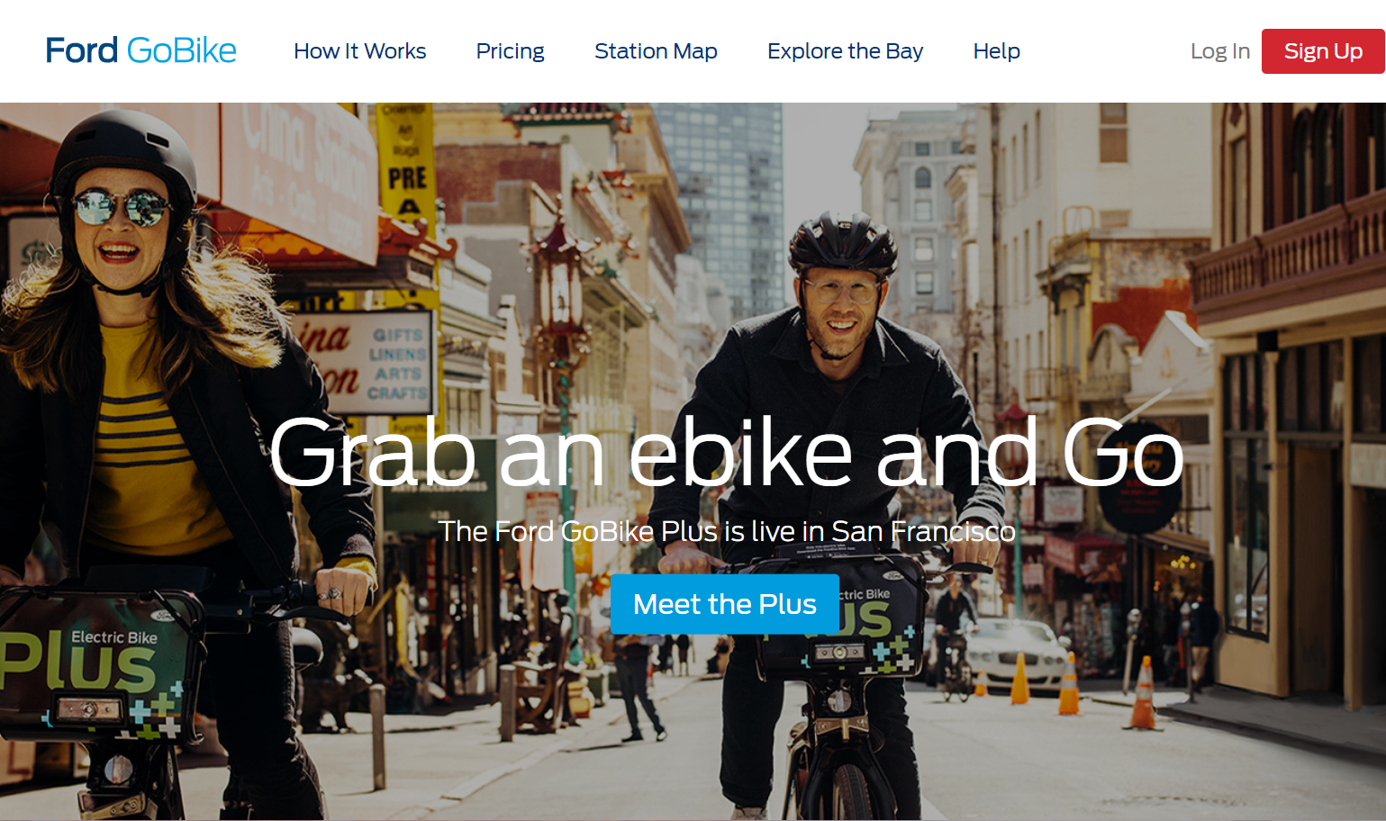
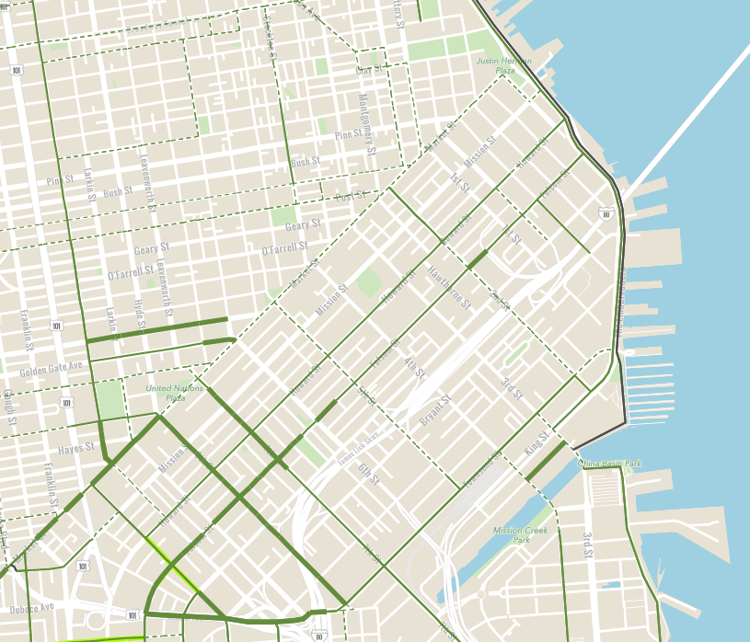
Bike Sharing: Why the passion?
Bikes and urban centers work together
Low congestion
Scalable transportation solution
Green
Healthy
Accessible (don’t need 40 acres)
If it’s relevant enough for GIS…

Slide 21

Graph Theory: Where’s the leverage?
Graphs are efficient representations for processing
Availability of great libraries for processing graphs
Graphs are both hip and now…
1
2
3
C
A
B
E
D
F

Slide 22
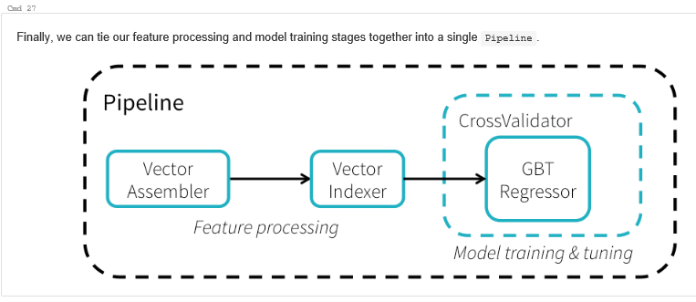
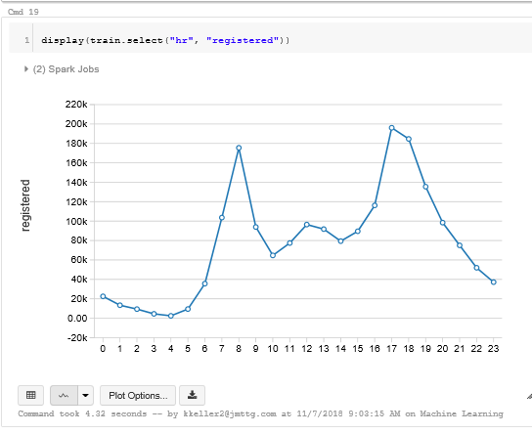
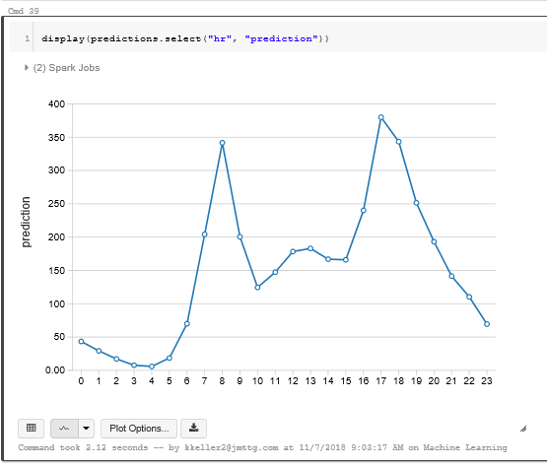
Machine Learning: Where’s the Leverage?
Databricks Maps the Pipeline
Databricks Provides the Reuse
Training Data
Predicted Result

Slide 23

Databricks Examples
DEMO

Slide 24
Quickstart: Hello World of Databricks
DEMO
Create a Data Frame and read in the data from a csv file
View the schema
View the data using SQL statements
Display the data
Now try it with Python
Python invoked with magic prompt: %Python
%LANGUAGE (SQL, Python, Scala, R, Java)
Notice documentation mark down (%md)

Slide 25
Bike Stations: Analyze the Graph
DEMO
GraphX has a number of algorithms for analysis
PageRank – determines importance of a webpage based on link number and quality
Connected components, label propagation, SVD++, etc.
What are the most common destinations?
Using Scala SQL on the edges of the graph
What’s going into and out of the stations?
Recall that vertex degrees measure connectedness of graph
Use the fact that trips are directed, so we have a directed graph
Access “indegrees” and “outdegrees”
What are the biggest sinks for bike trips?

Slide 26
Bike Usage: Overview
DEMO
Goal: Predict the usage of bikes according to time of day
Bike count becomes the target for learning
Method: Build a learning “pipeline” that includes –
Target label, bike count
Feature vector, e.g. time of day, weather, etc.
Hyperparameter tuning grid, e.g. number of iterations or depth
Evaluation Metric
Validator

Slide 27
Bike Usage: Setup
DEMO
Create a Data Frame from the csv file (17K rows of usage data)
Recall that Data Frames (DF) are distributed columnized data
Cache the DF to keep it in memory
Clean up the data
Check summary data sources and remove sources if using summary
Avoid self-fulfilling prophecy trap
Redundant, Irrelevant, Missing
Check data types and cast any needed to expected types

Slide 28
Bike Usage: Training
DEMO
Need to split the available data into training and testing samples
DF method “randomSplit” does this
Familiarize yourself with the data
Display the training portion of the data
Consider which columns might be used predictively
All, some, few?
These are part of the “feature vector” for predicting the target
Determine which features are categorical
Consider Values for hyperparameters
Values set *before* training as opposed to learned parameters

Slide 29
Bike Usage: Parameter Tuning
DEMO
HyperParameter tuning is a search problem
There are many methods available
Exhaustive search (grid methods)
Bayesian
Genetic
Spark provides a grid method
Form a grid of parameter settings using Cartesian product of parameter sets
Pick an element of the grid
Run the learning strategy using the chosen parameter settings
Calculate the RMSE
Iterate

Slide 30
Bike Usage: Feature Processing and Learning
DEMO
Spark provides utilities to create feature vectors
Assembly
Indexing
Easily use all columns except the ‘target’ for the vector
VectorIndexer
Identities categorical features
Indexes them
Spark provides a library of learning strategies
e.g. Gradient-boosting trees (a form of gradient descent search)

Slide 31
Bike Usage: Results Examination
DEMO
After running pipeline model, call transform to get predictions
Display the predictions as a DF to inspect results
Should be able to observe a rough correlation of target to prediction
Check the RMSE evaluator against the predictions
Visualize the result
Does the model graphic “look” like the training set?
Consider modifying the ML system
Are there opportunities to combine or separate features?
Can better/more hyperparameters being considered with a different grid?
Can we build more features knowing what we know about domain?

Slide 32
Bike Usage: Results Examination
DEMO
After running pipeline model, call transform to get predictions
Display the predictions as a DF to inspect results
Should be able to observe a rough correlation of target to prediction
Check the RMSE evaluator against the predictions
Visualize the result
Does the model graphic “look” like the training set?
Consider modifying the ML system
Are there opportunities to combine or separate features?
Can better/more hyperparameters being considered with a different grid?
Can we build more features knowing what we know about domain?

Slide 33
Dev and development
DEMO
Saving Analysis Work
Deploying
Lifecycle

Slide 34
Saving Analysis
DEMO
Notebook contains not only the results but the work
Data bases used
Connections
Imported libraries to support analysis
Intermediate results
“What if” variants
The days of analyze and print results are gone!
File functionality:
Clone, export, publish, etc.

Slide 35
Model Deployment
DEMO
Goal: Re-Use the effort put into building analytic models by making them usable in/by external systems
Process:
Train the model
Export the model
Import the model into an external system
Primary Tools
MLeap – serialization format supporting Spark
MLeap bundles are portable
http://mleap-docs.combust.ml/

Slide 36


DISCUSSION
Possible Application Areas
CAV sharing?
Traffic Network Analysis
MTA Usage Analysis
Integrated Transportation Network Analysis
Congestion Prediction
Time of day
By mode
Integrated – airport + traffic = schedules?

